Slide 1
Click reports

Slide 2
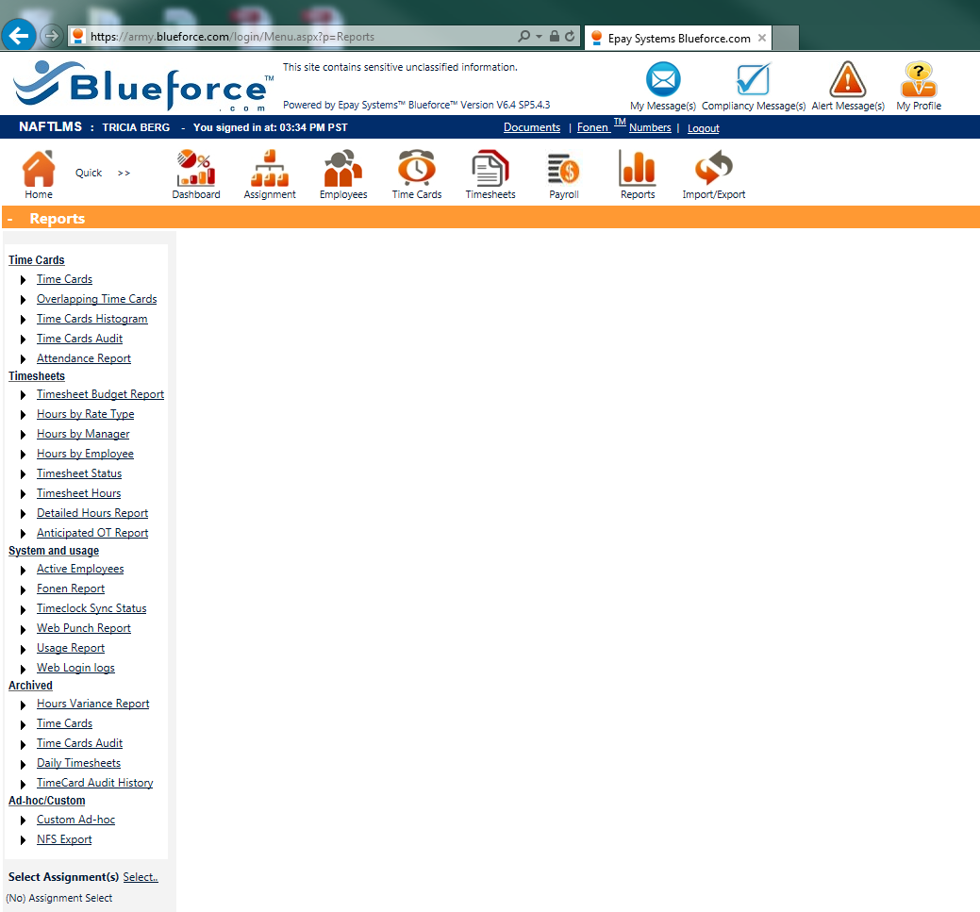
Click NFS Export

Slide 3
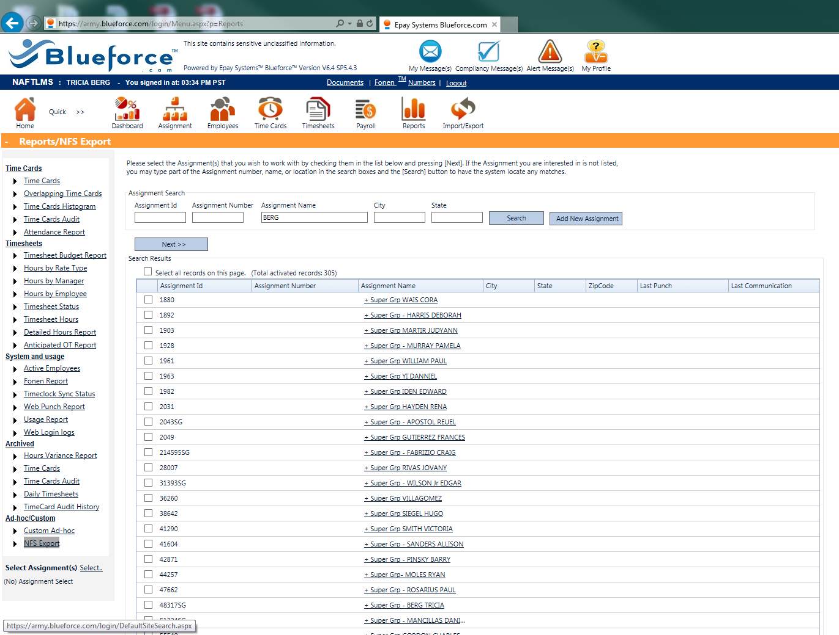
Add the last name of the employee and click search

Slide 4
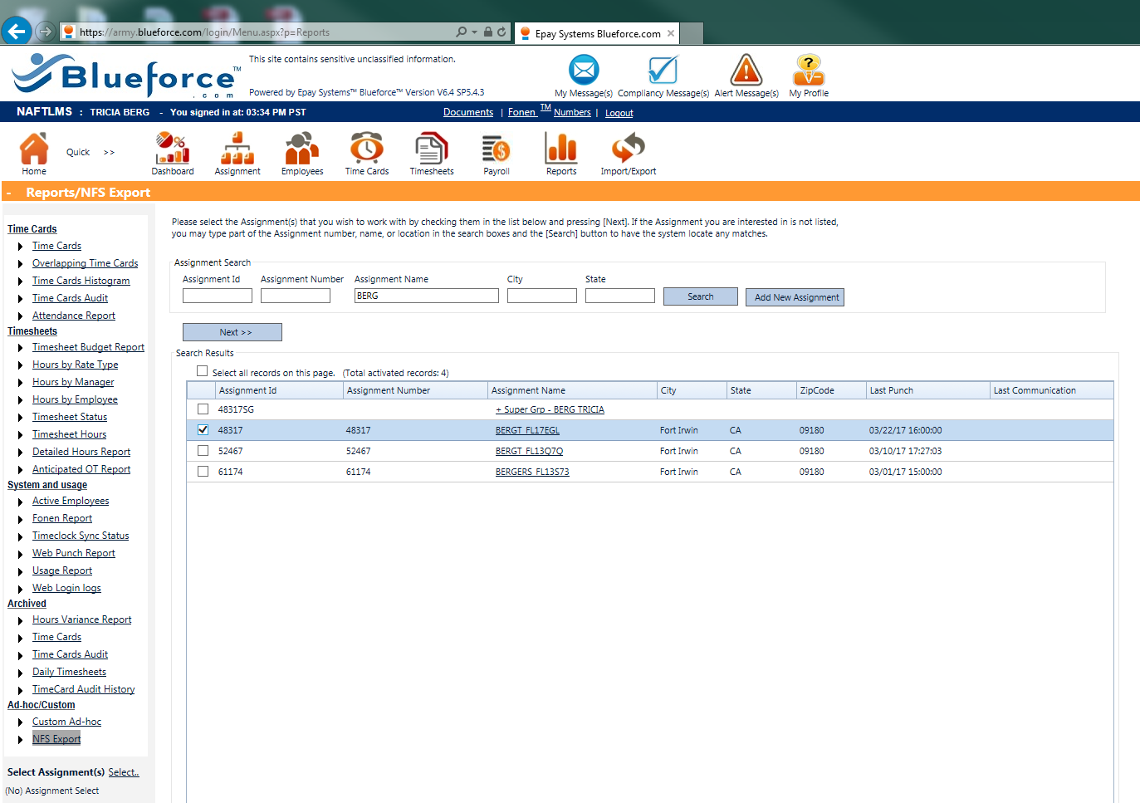
Check the employee and click Next

Slide 5
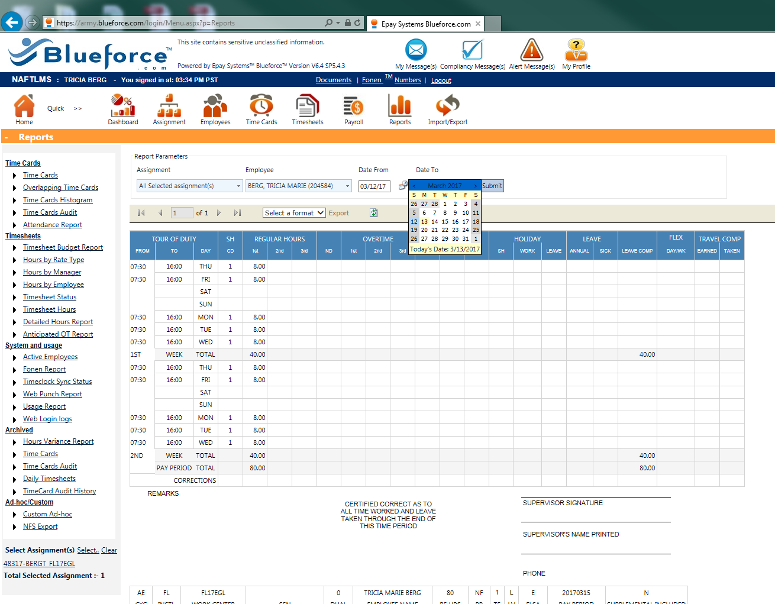
Be sure you have the correct date range selected

Slide 6
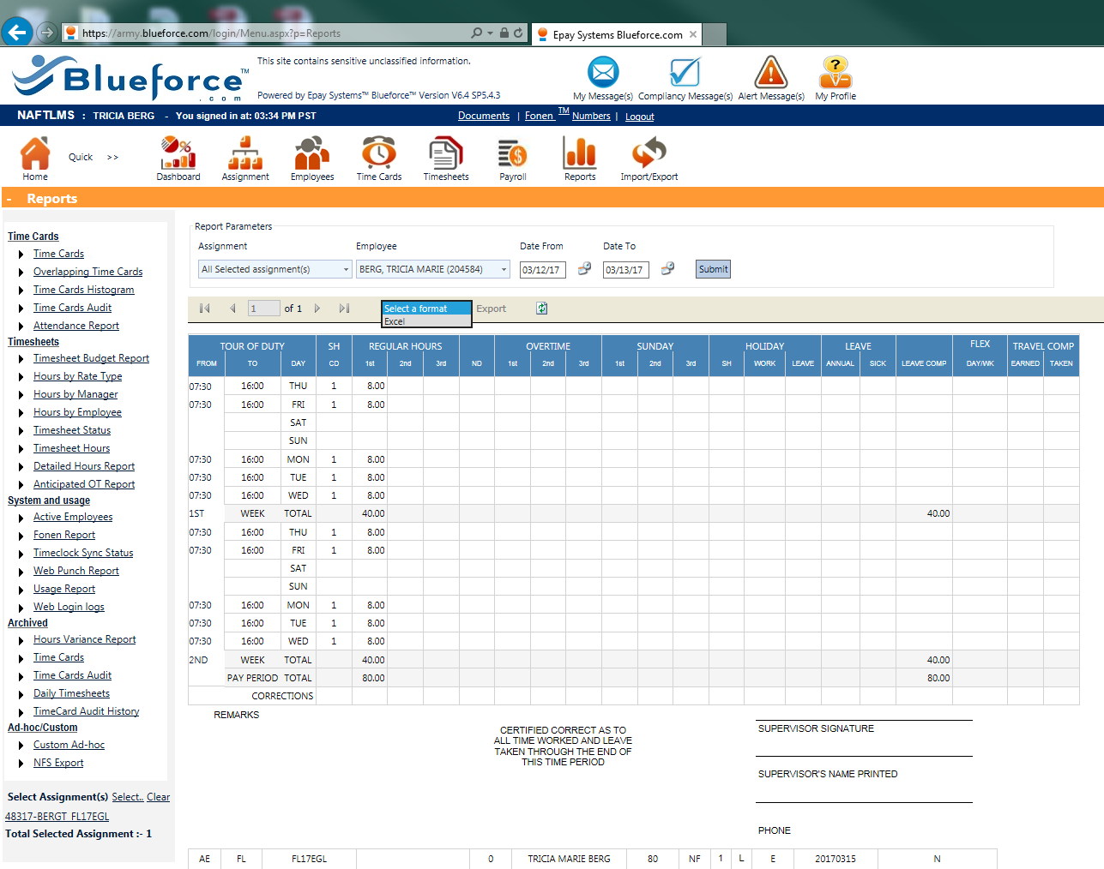
Select Excel from the drop down (it should be the only option) and click Export

Slide 7
A pop will ask you to save, click save. Another pop up will click ask you to open, click open. The 4850 will open in excel like the picture on the left. Be sure to enable all functions to be able to properly format the 4850 for acceptance from DFAS.
**Please note DFAS will not accept improperly formatted 4850s**

Slide 8
Under PAGE LAYOUT:
Change the “Orientation” to LANDSCAPE
Change the “Margins” to .2 TOP AND BOTTOM and .25 LEFT AND RIGHT

Slide 9
In VIEW:
Click Page Break Preview
The screen will look like the picture on the left.
Move the vertical dotted line out to the solid blue line.
Move the horizontal dotted line up to the top of the Supplement timecard
2. This is the top of the supplement bottom of the 4850.

Slide 10
This is what a properly formatted 4850 looks like. Click normal view

Slide 11
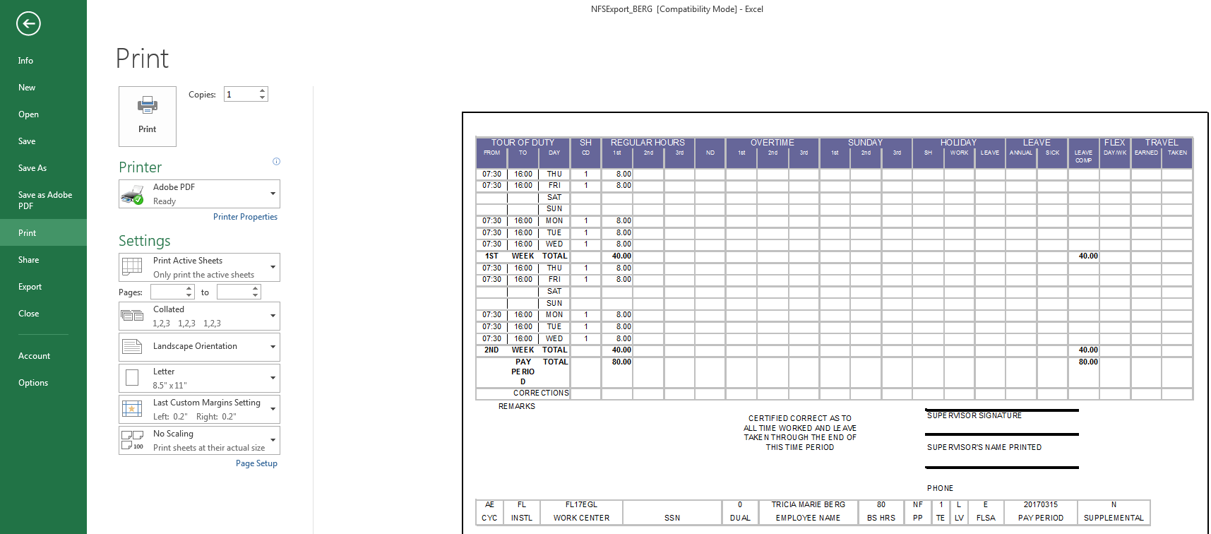
Be sure you can read on the information on this bar ESPECIALLY THE NAME. If you cannot you will need to make the row wider to show the full name

Slide 12
This is how a corrected 4850 will look.
Sign, Print and add your phone number.
Make sure you add your employees SSN.
Make sure the hours are correct and the leave comp is correct.
INITIAL EVERY MAKRING, CORRECTION, CHANGE
Make sure the hours reflect the correct shift

Slide 13
Then get to FM for final processing:
Email your Location POC (Encrypt the email)
Bring it to RM 4 BLDG 1317
(DO NOT JUST DROP IT ON SOMEONE’S DESK) This is PII Please hand it directly to someone to ensure processing or put a Privacy Act cover on it and lay it on you Location POCs keyboard. There are Privacy Act covered in the square table in the waiting area in FM.
Then be sure to follow up to ensure your employee is properly paid.

